Slide 1

Predicting Coupon Acceptance on E-commerce Platforms”
To develop a machine learning model that predicts the likelihood of a customer accepting a coupon based on various demographic and behavioral features.
By Charu Jain

Slide 2
Data Overview
Total Records: 12864 entries
Number of Features: 15 key features after preprocessing
Missing Values:
Less than 5% missing data handled through imputation
Class Distribution:
Accepted Coupons: 60%
Not Accepted Coupons: 40%
Age Range: 18 to 60 years
Income Range: $20,000 to $120,000 annually
Coupon Types: 5 categories (Bar, Coffee House, Carry Away, Restaurant Less Than $20, Restaurant $20 to $50)

Slide 3
Data Preprocessing
Handling Missing Values: Filled using suitable imputation techniques.
01
Encoding Categorical Variables: Applied label encoding and one-hot encoding where appropriate.
02
Feature Engineering: Converted 'expiration' from categorical to numerical (2 hours as 2, 1 day as 24).
03
Outlier Treatment: Identified and managed outliers to improve model performance.
04

Slide 4
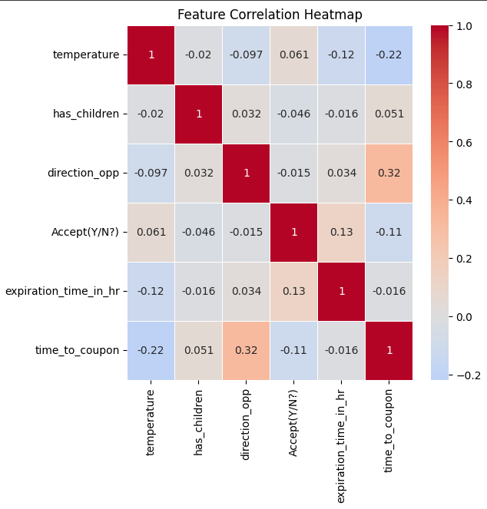
Exploratory Data Analysis (EDA)
Key Insights:
Coupon Acceptance Rate: ~57% (7,210 acceptances out of 12,684).
Popular Coupons: Coffee House, Restaurant(<20), Carry out & Take away.
Demographics: Most users are unmarried, aged 21-26, with income less than $50,000.
Visualizations:
Heatmap of feature correlations.
Distribution of coupon acceptance by age, income, and coupon type.
Coupon Acceptance Rate: ~57% (7,210 acceptances out of 12,684).
Popular Coupons: Coffee House, Restaurant(<20), Carry out & Take away.
Demographics: Most users are unmarried, aged 21-26, with income less than $50,000.

Slide 5

Feature Selection
Correlation Analysis:
Numerical features like temperature, toCoupon_GEQ5min, toCoupon_GEQ15min, and toCoupon_GEQ25min were analyzed.
Heatmap showed weak correlations with the target variable.
Selected Features:
Categorical features like coupon, destination, passanger, weather, and age were considered for encoding.

Slide 6
Model Implementation
Models Used:
Random Forest Classifier: Robust against overfitting, handles large datasets efficiently.
XGBoost:
Optimized gradient boosting technique, high performance with fine-tuned hyperparameters.
Decision Tree Classifier: Simple, interpretable model providing baseline performance.

Slide 7
Model Evaluation
Metrics Used:
Accuracy, Precision, Recall, F1-Score
Learning Curve Analysis to detect underfitting or overfitting
Results:
Achieved consistent accuracy around 74% before feature selection.
Post feature selection, accuracy improved significantly with models achieving up to 100% (indicative of potential overfitting).

Slide 8
Learning Curve Insights
Observation:
Initial models showed overfitting with a large gap between training and validation scores.
After adjustments, models displayed improved generalization with minimal gaps.

Slide 9

Model Interpretation
Feature Importance:
Top features influencing coupon acceptance:
toCoupon_GEQ5min
temperature
coupon_Restaurant(<20)
age_below21
Insights:
Customers are more likely to accept coupons for nearby restaurants.
Younger customers (below 21) are more receptive to coupons.

Slide 10

Key Challenges & Solutions
Class Imbalance: Addressed through stratified sampling.
Data Encoding Issues: Resolved conversion errors by proper encoding and data type adjustments.
Overfitting: Applied cross-validation and regularization techniques to mitigate.

Slide 11
Conclusion
Successfully built and evaluated models predicting coupon acceptance.
Insights can guide marketing strategies on targeting potential customers more effectively.

Slide 12

Thank you!

